Slide 1
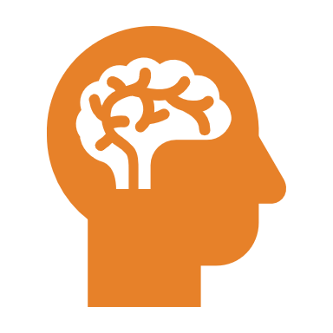
Biological bases of behaviour

Slide 2
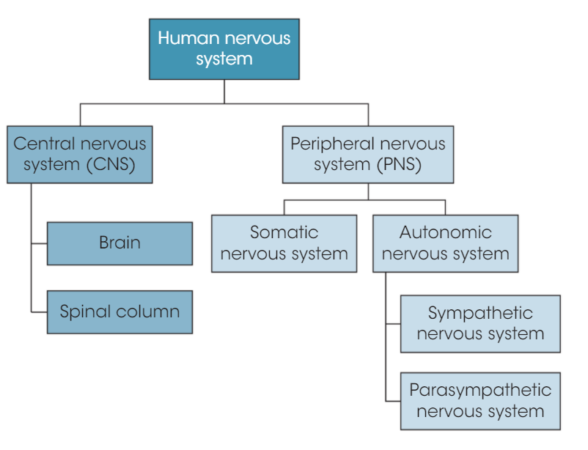
Divisions of the nervous system

Slide 3
Terminology
Contralateral – affecting the opposite side of the body e.g. damage to the left side affects right motor movements
Ipsilateral – affecting the same side of the body as hemisphere of the brain

Slide 4
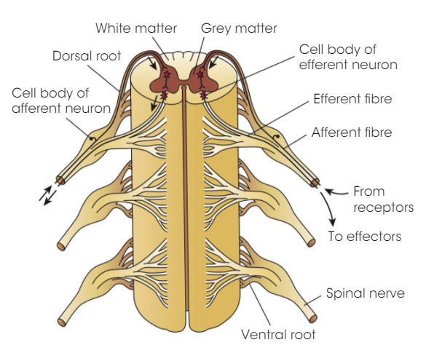
Spinal Cord
Efferent = motor neuron (effects) – lead to ventral (front) side
Afferent = sensory neuron (affective) – lead to dorsal (back) side
Consists of 31 segments (each containing a pair of spinal nerves)
NB: also the 12 cranial nerves

Slide 5
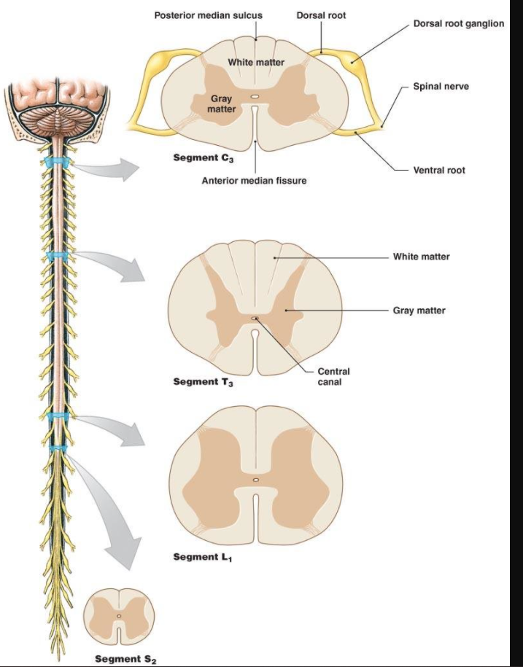
Spinal Cord
Efferent = motor neuron (effects) – lead to ventral (front) side
Afferent = sensory neuron (affective) – lead to dorsal (back) side
Consists of 31 segments (each containing a pair of spinal nerves)
NB: also the 12 cranial nerves

Slide 6
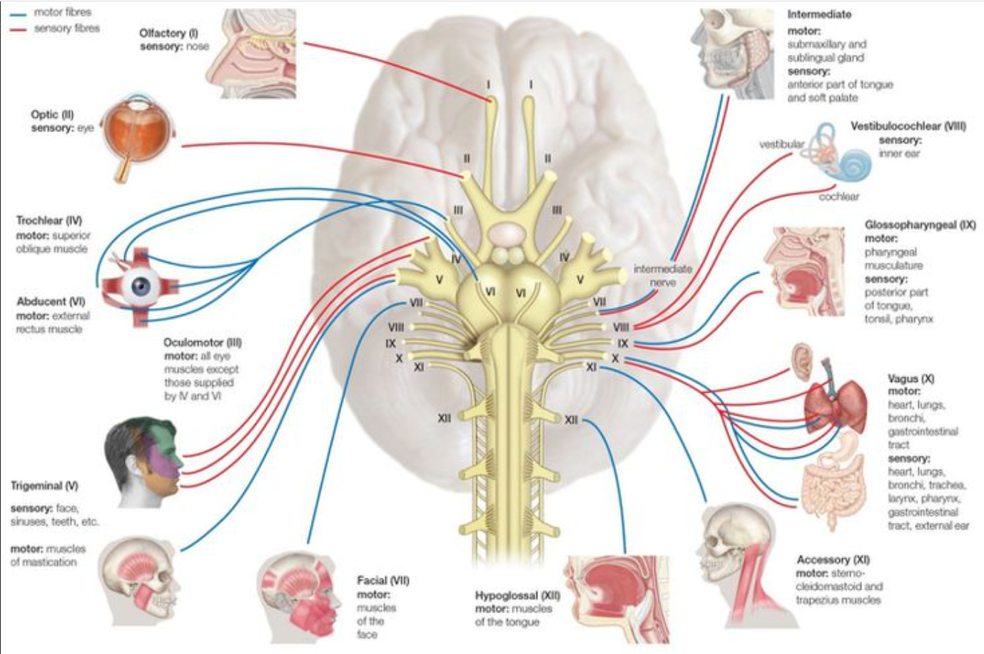
Cranial nerves

Slide 7
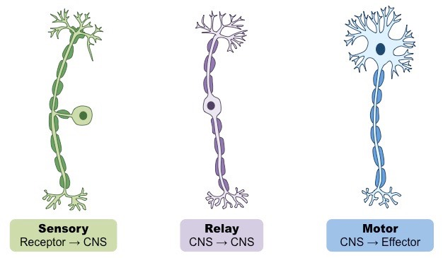
Types of neurons
-motor, sensory, relay/interneurons

Slide 8
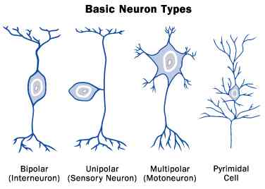
Types of neurons

Slide 9
Common Neurotransmitters
Neurotransmitter | Function
Dopamine | Learning, attention and pleasurable sensations Parkinson’s caused by degeneration of neurons that produce dopamine
Serotonin | Transmits impulses between/along nerves Constricting smooth muscles (bodily processes) Sleep and mood (low serotonin linked to depression)
Noradrenaline | Hormone AND neurotransmitter Stress, danger, also memory retrieval Physiological effects – increase heart rate and blood pressure by widening air passages and narrowing blood vessels Dysfunction also associated with mental disorders esp. depression
Endorphins | Regulate feelings and perceptions of pain Released when the body is stressed and in positive mood (e.g. runners high)

Slide 10
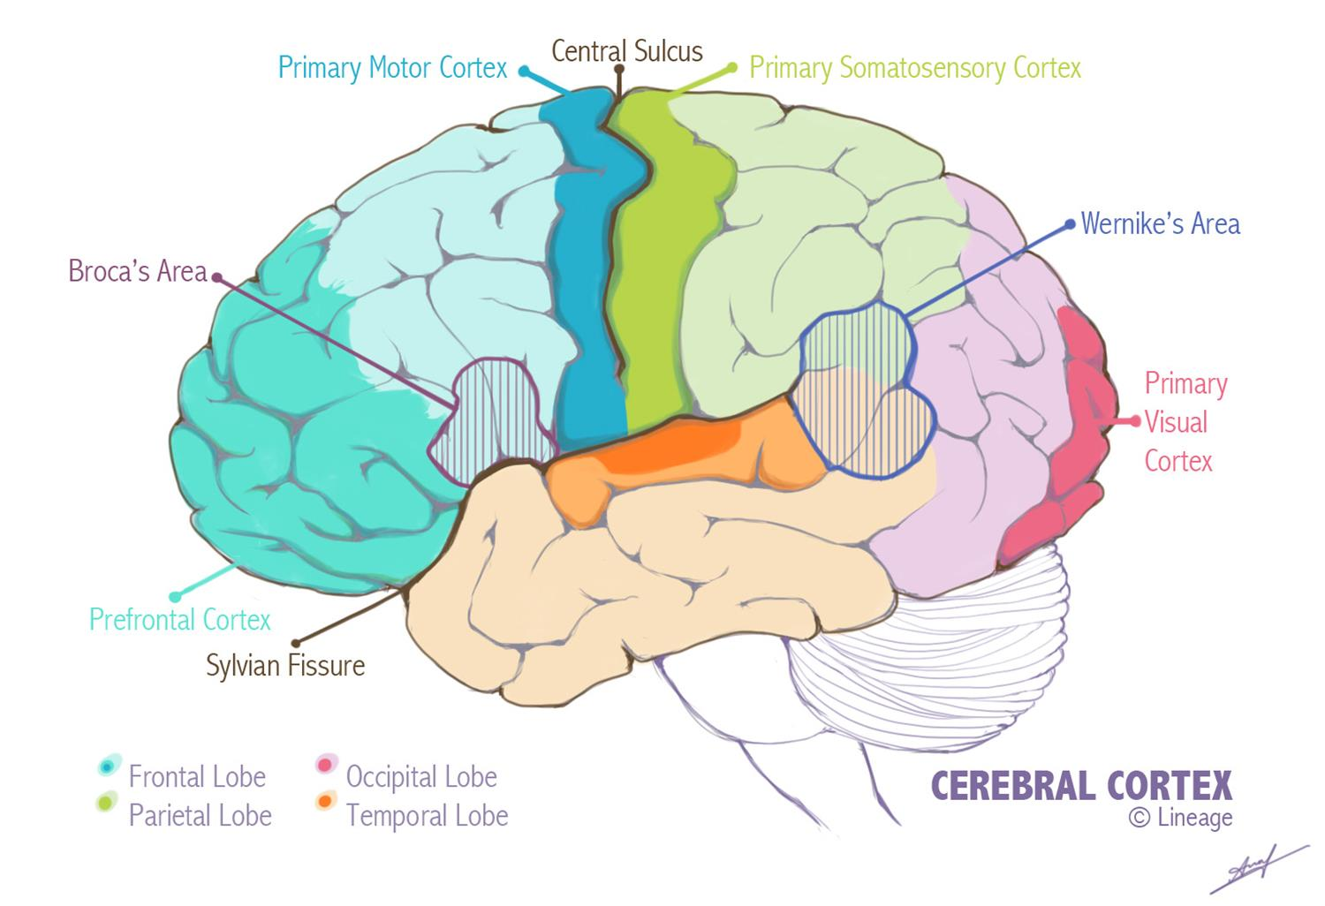

Slide 11
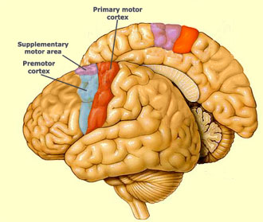
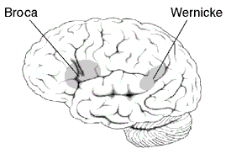
Frontal lobe
Primary motor cortex
strip just before the central sulcus
Controls voluntary movements on the opposite side
Broca’s area
Left frontal lobe
Producing speech
‘Broca’s aphasia’ = deficit in language production
(Wernicke’s area)
Left temporal lobe
Understanding speech

Slide 12
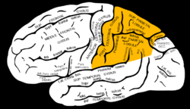
Parietal lobe
Bodily sensations – e.g. touch, temperature, pain
Sensory input from right of body goes to left brain and vice versa
Spatial awareness
‘parietal – associated cortex’ enables reading, writing and solving maths problems
Right hemisphere damage = loss of visualisation and spatial relationships
Left hemisphere damage = problems in maths, reading and writing

Slide 13
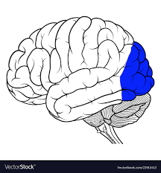
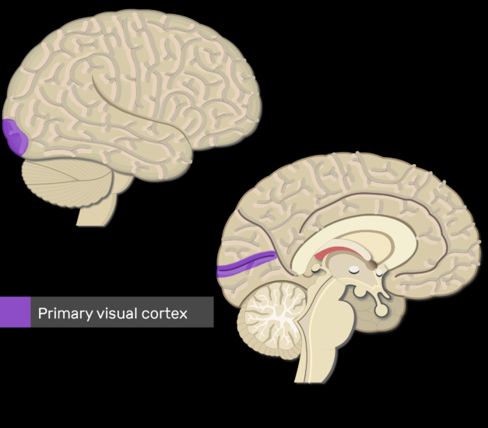
Occipital lobe
Vision
‘primary visual cortex’ – receives visual info from retinas
Visual perception and colour recognition
Damage = blindness, partial blindness or ‘word blindness’ (alexia or agraphia)
Note: not prone to accidental damage due to location

Slide 14
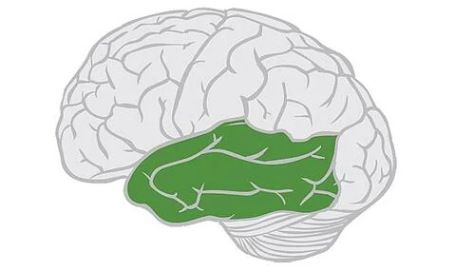
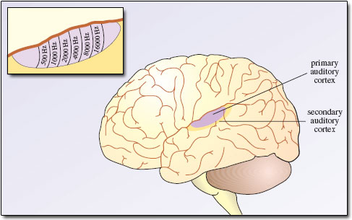
Temporal lobe
Hearing
Language and speech production and memory
Limbic system, amygdala and hippocampus located inside
Also Wernicke’s area
Auditory cortex

Slide 15
Epigenetics
Transmission of information from one generation to the next that affects traits but does alter the DNA sequence
‘environmental influences’ – BUT environment can also mean internal environment e.g. hormones

Slide 16
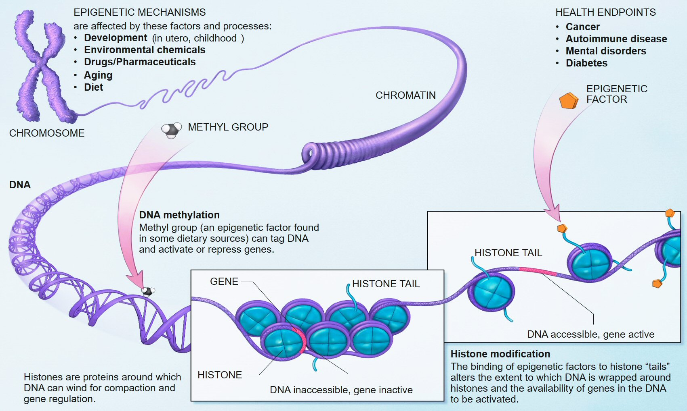
Epigenetics

